Slide 1
Solid State Drive Overview
David H.C. Du
Department of Computer Science & Engineering
University of Minnesota, Twin Cities

Slide 2
Outline
Overview
FTL Designs
Wear-Leveling and Garbage Collection
Flash as Primary Memory
SSD for Power Saving
Applications: SSD for Checkpointing
SSD Reliability Issue

Slide 3





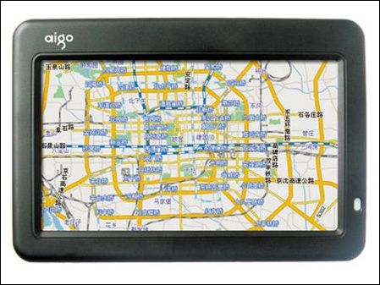

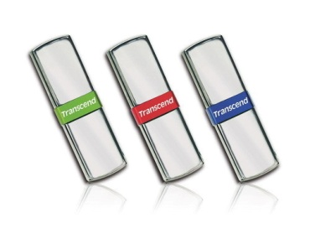
Introduction – Why Flash Memory
Diversified Application Domains
  Portable Storage Devices
  Consumer Electronics
  Industrial Applications
  Critical System Components
  Enterprise Storage Systems
Notes:
由於 flash memory 有 non-volatility, shock-resistance, 及 low-power consumption 的特性，因此越來越多領域採用 flash memory來儲存資料及程式碼。
其應用領域從消費性電子產品以至個人電腦、機器人及航太產業。
Small size, non-volatility, shock-resistance, low-power consumption, lost cost
Becuase System on a Chip and hybrid devices are becoming more and more popular,

Slide 4
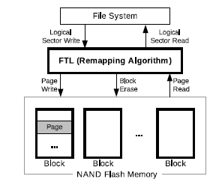
Flash-based SSD Characteristics
Random read is the same as sequential.
Read and write by the unit of pages
Does not allow overwrite. Need erase before writes. Erase is performed in blocks
Typical block size is 128 K and page size 2K
Write is slower than read. Erase is a very slow operation
Read takes 25 microseconds, write takes 200 microseconds, and erase takes 1500 microseconds
Limited number of writes per cell. 100 K for SLC and 10K for MLC.
Flash Translation Layer (FTL) sits in between file system and SSD. FTL provides remapping and wear-leveling
SSD

Slide 5
DRAM, PC-RAM, NAND Flash and NOR Flash Comparison (Mogul et al 2009)
Technology | Density | Endurance (cycles) | Rand. read time | Write time | Erase time | Erase Size | Idle “on” power
DRAM | 6-8 F² | 10¹⁵ | ∼ 40–60 ns | ∼ 40–60 ns | — | — | _4W–8W/DIMM
NAND flash | 4-5 F² | 10⁵ –10⁶ | 5–50 us | 200 us/page | 2 ms | e.g. 512KB | _0
NOR flash | 10 F² | 10⁵ –10⁶ | 70 ns | 1 us | 1 sec | e.g. 128KB | _0
PC-RAM | 8-16 F² | 10¹⁰ –10¹¹ | 60 ns? | 100–1000 ns | — | — | _0

Slide 6
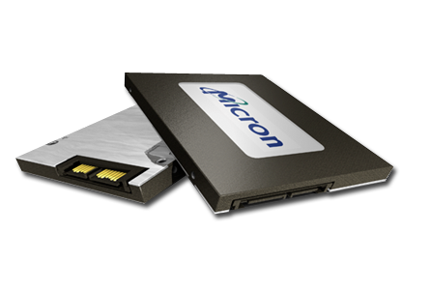
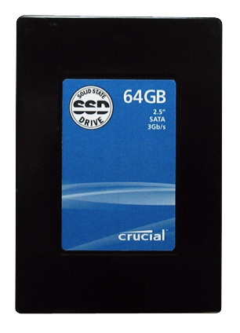
Solid State Disk (SSD)
A semiconductor-based block storage device acts like a virtual hard disk drive
Flash Based
  Non-volatile, best random read performance,
  NOR and NAND Type
  Same class of memory used in consumer electronics
DDR Memory Based
  Volatile, very fast read and write, costly, needs batteries and backup HDDs for non-volatility
  Same class of memory used in enterprise storages
Cached Flash
  Mix of DDR memory and NAND type flash

Slide 7
Power consumption
 | Approximate Power Consumption | mW/GB
DRAM DIMM Module (1GB) | 5W | 5000
15K RPM Drive (300GB) | 17.2W | 57.33
7.2K RPM Drive (750 GB) | 12.6W | 16.8
High Performance SSD (128 GB) | 2W | 15.6
Source: Flash Storage Today, ADAM Leventhal, ACM Queue, 2008

Slide 8
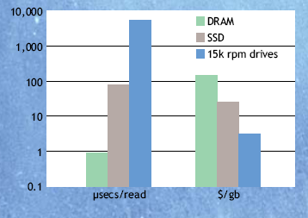
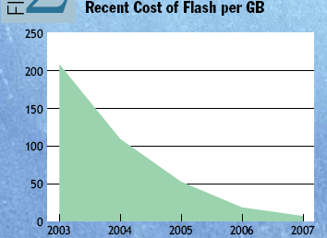
Price and Performance
Source: Flash Storage Today, ADAM Leventhal, ACM Queue, 2008

Slide 9
Over-Write in Flash Memory

Slide 10
What is FTL?
A software layer that makes flash memory appear to the system like a disk drive
  Sector mapping: logical sector <-> physical page
  Garbage collection
  Power-off recovery
  Wear leveling and bad block management

Slide 11
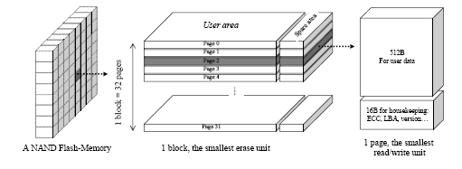
NAND FLASH Memory Architecture

Slide 12
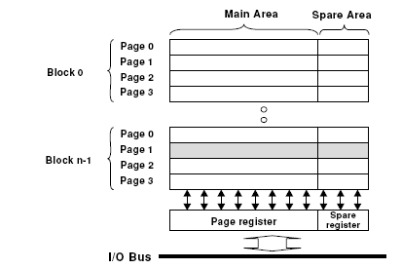
NAND flash structure.

Slide 13
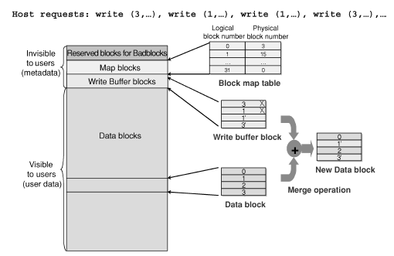
Logical view of the FTL of NAND flash memory.
Paper: A reconfigurable FTL (flash translation layer) architecture for NAND flash-based applications. ACM Transactions on Embedded Computing Systems (TECS), 2008.

Slide 14
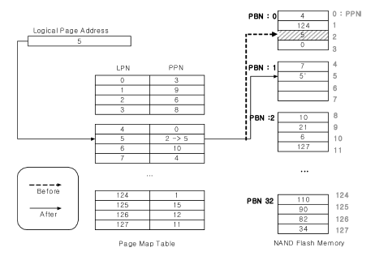
Page-Level Mapping (FTL)

Slide 15
Problems
For example, 256MB NAND flash with a page size of 512 bytes needs 524,288 (256*1024*1024/512) entries
Assume that an entry needs 4 bytes, the address translation information of FTL requires 2,048KB memory space.

Slide 16
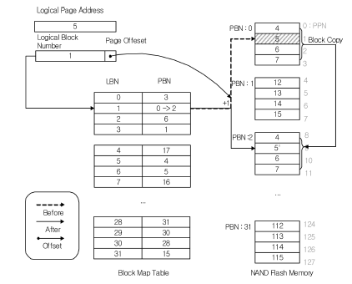
Block-Level Mapping (NFTL)

Slide 17
NFTL
  NFTL would need 64KB memory space to store 16,384 (256*1024/16) entries for 256MB NAND flash.
    Assume that a block consists of 32 pages.

Slide 18
FTL Vs. NFTL
 | FTL | NFTL
Memory Space Requirements | Large | Small
Address Translation Time | Short | Long
Garbage Collection Overhead | Less | More
Space Utilization | High | Low

Slide 19
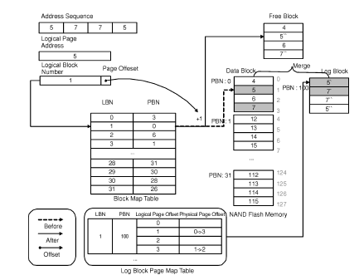
Hybrid Mapping

Slide 20
SNU FTL = BAST
BAST: Block Associative Sector Translation
Sectors from one logical block
can be mapped only to one log block
Flash
Memory
0
3
1
1
2
0
3
1
Original Data Blocks
Log Blocks

Slide 21
FAST
Fully associative sector translation” in log buffer blocks
Sectors from one logical block
can be mapped to any log block
0
1
Flash
Memory
1
3
2
0
3
1
Original Data Blocks
Log Blocks
Paper: A log buffer-based flash translation layer using fully-associative sector translation, ACM Transactions on Embedded Computing Systems (TECS),2007

Slide 22
AFTL – Coarse-to-Fine Switching
AFTL doesn’t erase the two blocks immediately.
2. AFTL moves the mapping information of the replacement block to the fine-grained hash table by adding fine-grained slots.
3. The RPBA field of the corresponding mapping information is nullified.
Paper: An Adaptive Two-Level Management for the Flash Translation Layer in Embedded Systems, CuChin-Hsien Wu and Tei-Wei Kuo, ICCAD, 2006.

Slide 23
AFTL – Fine-to-Coarse Switching
The number of the fine-grained slots is limited.
  Some least recently used mapping information of fine-grained slots should be moved to the coarse-grained hash table.
Assume that this fine-grained slot is to be replaced.
Data stored in the page with the given (physical) address are copied to the primary or replacement block of the corresponding coarse-grained slot, as defined by NFTL.
(F, PBAE)
3. If there dose not exist any corresponding coarse-grained slot, a new one is created.

Slide 24
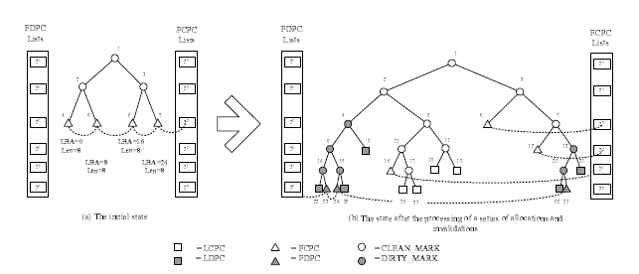
Tree-Based Mapping
Paper: Li-Pin Chang and Tei-Wei Kuo, "Efficient Management for Large-Scale Flash-Memory Storage Systems with Resource Conservation," accepted and to appear in the ACM Transactions on Storage, 2005

Slide 25
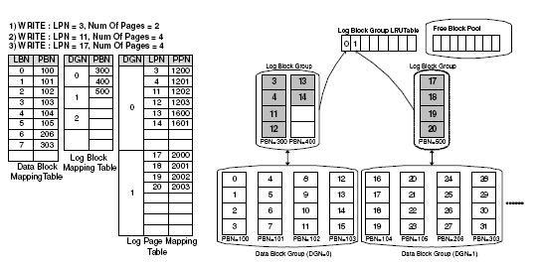
Reconfigurable FTL
Paper: A reconfigurable FTL (flash translation layer) architecture for NAND flash-based applications. ACM Transactions on Embedded Computing Systems (TECS), 2008.

Slide 26
CFTL: A Convertible FTL

Slide 27
Page-Level vs. Block-Level
Page-Level Mapping
  High Block Utilization
  Best Performance for Both Read and Write
  Write-Intensive Data
  Require Large Amount of Memory
Block-Level Mapping
  Require Less Memory
  Good for Read-Intensive Data
  Bad for Write-Intensive Data

Slide 28
Existing Hybrid Approaches
Data Blocks: Block-Level Mapping; Log Blocks: Page-Level Mapping
  BAST (Block Associative Sector Translation)
    Exclusively associates a log block with a data block
  FAST (Fully Associative Sector Translation)
    Allows log blocks to be shared by all data blocks
  LAST (Locality-Aware Sector Translation)
    Provides multiple sequential log blocks to exploit spatial locality
  SuperBlock FTL
    Combines consecutive logical blocks into a superblock to exploit spatial and temporal locality
Page-Level Mapping Implemented on Flash
  DFTL (Demand-based page-mapped FTL)

Slide 29
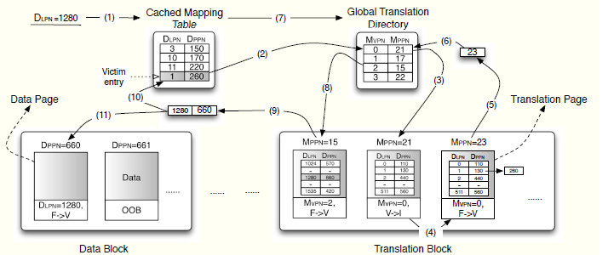
DFTL Architecture
Address translation processes

Slide 30
Convertible FTL (CFTL)
Basic idea
  Support A Complete Page-Level Mapping like DFTL
  Also Support A Small Block-Level Mapping like (FAST/BAST)
  Convert Data Blocks between The Two Based on Its Data Access Pattern.
  That is,
  Hot Data Blocks in Page-Level Mapping
  Cold Data Blocks in Block-Level Mapping
  A Small Cache Table for Page-Level Mapping and Another for Block-Level Mapping
Notes:
Bloom filter

Slide 31
Performance Comparison
Read-Intensive

Slide 32
Performance Comparison
Random: Mixed Reads and Writes

Slide 33
Performance Comparison
Write-Intensive

Slide 34
Efficient Wear-Leveling for Flash-based SSD

Slide 35
SLC vs. MLC
MLC write constraints
  Partial-page programming prohibition
  Sequential page writes in a block
SLC: single level cell
MLC: multiple level cell
 | Cost³ (US $/GB) | Density¹ (Bit/Cell) | Speed¹ (R/W: Mbps) | Endurability¹ (Erase cycles) | Reliability² (Bit error rate)
SLC | 4.46 | 1 | 128 / 46 | 100,000 | 10⁻⁹
MLC_{x2} | 1.4 | 2 | 108 / 20 | 10,000 | 10⁻⁶
[1] Electronic Engineering Times, 07 2005.
[2] R. Dan and R. Singer. Implementing MLC NAND Flash Memory for Cost-Effective, High-capacity Memory. M-Systems, 03 2003.
[3] DRAMeXchange. Flash Contract Price,http://www.dramexchange.com/, Jan 2009.
Notes:
Flash memory 又可分為 SLC 及 MLC，SLC 就是每個 cell 可存放一個 bit 的資料，而 MLC 的每個 cell 可以存放 2 個 bit 以上的資料。
不過，MLC 有一些新的 write constraints，也就是每個 page 不可分成多次寫入資料，且同一個 block 內的資料必須要從 page 0、page 1 循序寫下來。
讓我們來比較一下 SLC 及 MLC 的特性，從這個表可以看出 MLC 的 cost 卻不到 SLC 的 1/3，且 density 是 SLC 的 2 倍以上，但是它的 endurability 及 reliability 都比 SLC 低很多。

Slide 36
Garbage Collection - Wear Leveling
Live-page copying
A
A
B
B
C
C
D
F
D
B
A
C
D
E
F
A
F
A
C
D
F
C
D
F
A
B
C
D
E
F
: page contains hot data
: free page
: dead page
: page contains cold data
Notes:
關於 Endurability 的 issue，我們可以先看一個 Garbage collection 例子：
假設有 6 個 write requests 分別為 ABCDEF，其中紅色的為 hot data，也就是經常被 update 的 data，而藍色的為 cold data，也就是不常被 update 的 data。
一開始，資料就依序 ABCDEF 被寫入兩個 blocks，過一阠 ACDF 這一些 hot data 又被 update 了一次，於是原來的資料就變成過期的資料(invalid data)，這時系統只剩一個 free block，所以就需要啟動 garbage collection，為了減少 live page copy 的 overhead，我們選擇 live page 最少的 block 來 erase，首先把 valid data B copy 到 free block，然後再把整個 block erase 掉。接下來 ACD 又被 update 一次，這時系統又只剩一個 free block，所以需要再啟動 garbage collection，於是就把 valid F copy 到 free space，然後把整個 block erase 掉。接下來 ACD 又 update 了一次之後又需要啟動 GC。
從這個例子我們會發現為了減少 live-page copy 的 overhead，我們儘量選擇有效資料比較少的 block 來 erase，但是造成存放 cold data 的 block 幾乎不會被 erase，造成存迎 hot data 的 block 很快就會被 wear out，也就是超過他們的 erase cycles。

Slide 37
Challenges of Flash Memory Management
Endurability
  Frequently updating of data might “wear out” flash-memory blocks.
    Wear leveling
      Increasing access frequencies
      Decreasing erase cycles
Reliability
  The error probability is exaggerated when the manufacturing density increases.
  Different error patterns impose challenges on error correction.
    Random error
    Burst error
Notes:
因為每個 block 可被 erase 的次數隨著 MLC 的發展則是越來越少，且 隨著 flash memory 被用在 high access frequency 的應用中，使得 flash memory 的使用壽命受到嚴重的挑戰，因此如何在不造成嚴重的 overhead 的情況下能夠平均分配 erases 到整個 flash memory 來提昇 flash 的壽命，已成為一個重要的挑戰。
同時，由於 MLC flash memory 的被使用，bit error probability 越來越高，且目前用在 flash memory 的 error correction 機制都無法有效的同時處理 random error 及 burst error，所以如何快速有效的提高 flash memory 的 reliability 亦成為一個非常重要的議題。
Out-Place Update
Updated data could be written somewhere else.
Tracking of the newest version of data must be done.
Bulk-Erasing
Pages are erased in a block unit to recycle used but invalid pages.
Wear-Leveling
Erasing of blocks must be done as evenly as possible.
A clever block assignment for write operations, due to out-place updates, must be provided.
Random error: errors on random bits
Read/write disturbs
Data retention
Premature oxide breakdown (cell failure)
Burst error: errors on consecutive bits
Address-line (bit line or word line) defect
Fast-erasing bit(/cell) – caused by over-erasing
All the cells connected to the same bit line of a depleted cell would be read as “1” irrespective of their actual content.

Slide 38

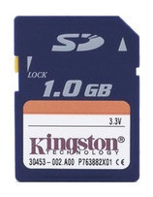
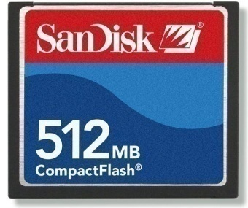
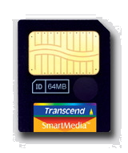
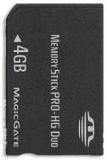

Motivation
A limited bound on erase cycles
  SLC : 100,000
  MLC_{x2}: 10,000
Applications with frequent access
  Disk Cache (e.g., Robson / TurboMemory)
  Solid State Disks (SSD)
Solid State Disk
Notes:
由於 flash memory 的 erase cycle 持續下降，且同時也被用在一些比較 high access frequency 的 應用上，如用來當做硬的 cache 及 solid state disk 來取代 硬碟。因此近年來 wear leveling 變得越來越重要。

Slide 39
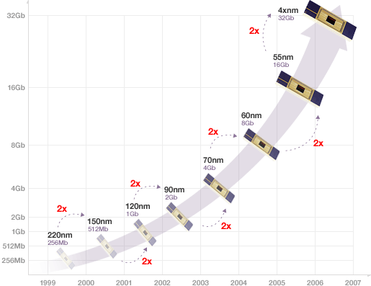
Design Considerations in Static Wear Leveling
Scalability Issues
  The limitation on the
  RAM space
  The limitation on
  computing power
Compatibility Issue
  Compatibility with
  FTL and NFTL
Source: NapkinLinks, Aug 2008
Notes:
然而在設計 static wear leveling 之時，我們同時需要考量到 scalability 及 compatibility 的 issue，由於 flash 的 capacity 幾乎是每年就會 double，而系統的 RAM space 及 computing power 不可能以同樣的速度提昇。
另外，目前大部分通用的 FTL design 並沒有使用 static wear leveling，因此我們的設計必須要能夠相容於目前的 FTL design，讓它們能夠很容易的加入我們所提的機制來達到 static wear leveling 的目的
In order to minimize the overhead, the proposed mechanism should be inserted into existing management schemes with limited modifications

Slide 40
An Efficient Static Wear Leveling Mechanism
A modular design for compatibility considerations
A SWL mechanism
  Block Erasing Table (BET)
    Bit flags
  SW Leveler
    SWL-Procedure
    SWL-Update
Notes:
因此，我們考慮的是一個 modular 的 design，也就是在現存的 FTL driver 之中加入一個 Static wear leveling 的 module，並且只需要與其 garbage collector 溝通就能把 block erase 平均地分散到整個 flash 系統。
在我們提出的機制之中只需要一個簡單的資料結構就能分辨 block erase 的分佈是否均勻，也就是 block erasing table，當 block erase 的分佈不均勻的程度超過一個限度，SW leveler 這個 procedure 就會被啟動來搬動資料，以使 block erase 的分佈能夠變得比較均勻。
Our approach only communicate with the Cleaner so that the only thing needs to modify is to add one interface function for the SW Leveler to communicate with the Cleaner.
To prevent any cold data from staying at any block for a long period of time.
BET is to remember which block has been erased in a pre-determined time frame.
The BET is a bit array and each bit corresponds to a set of contiguous blocks.
Whenever a block is erased, the corresponding bit is set.
Therefore, if a bit is not set for a period of time, it means that its corresponding blocks are blocks of cold data and they should be moved out.

Slide 41
Observations
Wearing at Data Blocks Can Be Naturally Balanced by
  Storing Hot Data Blocks in Less Worn Blocks
  Storing Cold Data Blocks in Most Worn Blocks
A Complete Balanced Wearing Can Only Be Possible Through
  Cold Data Migrations

Slide 42
Basic Idea
Use As Much As Natural Balancing As Possible
Wearing Do Not Needs to Be Completely Balanced at The Early Stage of Flash Memory
Wearing of Blocks Can Be Gradually Balanced at the End of Flash Life Span

Slide 43
Basic Algorithm Maintaining K Consecutive Lists of Blocks
Queue #
Block List
0
1
.
.
.
k
.
.
.
K is the allowed difference between Wear_Max and Wear_Min
100 K

Slide 44
Adaptive Wear-Leveling Algorithm
Use a large K at the beginning
Gradually reduce K to close to 0
This produce the best result when compared with a number of existing wear-leveling algorithms

Slide 45
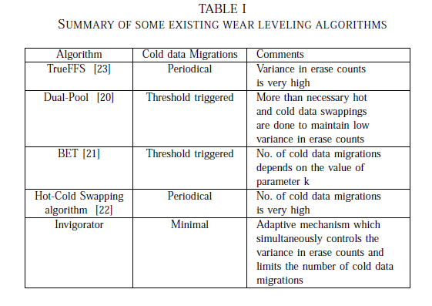

Slide 46
Lifetime = 20K(Financial 1)
Algorithm | When max erase count = 8K |  | No. Of write requests Serviced | When max erase count = 15K |  | No. Of write requests Serviced | When max erase count = 20K |  | No. Of write requests Serviced | No.of cold data migrations
 |  |  |  |  |  |  | Mean Erase count | Std Dev
 | Mean Erase count | Std Dev |  | Mean Erase count | Std Dev
Dual Pool | 7994 | 3.3 | 132.3M | 14997 | 3.1 | 364.1M | 19996 | 3.0 | 475.2M | 65K
Invigorator | 7364 | 6.1 | 135.2M | 14806 | 5.1 | 371.2M | 19998 | 2.75 | 573.2M | 33K

Slide 47
Lifetime = 20K(Financial 2)
Algorithm | When max erase count = 8K |  | No. Of write requests Serviced | When max erase count = 15K |  | No. Of write requests Serviced | When max erase count = 20K |  | No. Of write requests Serviced | No.of cold data migrations
 |  |  |  |  |  |  | Mean Erase count | Std Dev
 | Mean Erase count | Std Dev |  | Mean Erase count | Std Dev
Dual Pool | 7996 | 3.1 | 135.5M | 14998 | 3.2 | 368.1M | 19997 | 3.1 | 478.7M | 68K
Invigorator | 7532 | 6.3 | 136.4M | 14871 | 5.4 | 374.2M | 19998 | 2.7 | 574.1M | 35K

Slide 48
Lifetime = 20K(Financial 2)
Algorithm | When max erase count = 8K |  | No. Of write requests Serviced | When max erase count = 15K |  | No. Of write requests Serviced | When max erase count = 20K |  | No. Of write requests Serviced | No.of cold data migrations
 |  |  |  |  |  |  | Mean Erase count | Std Dev
 | Mean Erase count | Std Dev |  | Mean Erase count | Std Dev
Dual Pool | 7993 | 3.2 | 138.5M | 14997 | 3.2 | 371.2M | 19995 | 2.9 | 456.7M | 64K
Invigorator | 7721 | 6.1 | 140M | 14692 | 5.5 | 376.3M | 19998 | 2.7 | 568.1M | 31K

Slide 49
Improving Write Performance
Cache

Slide 50
Page-Level vs. Block-Level
MRU
1
5
6
2
32
16
7
17
LRU
Page-Level LRU
1
1
5
5
2
2
6
6
7
7
5
5
6
6
1
1
7
7
2
2
32
8
8
8
16
16
16
17
17
MRU
17
LRU
Block-Level LRU
Flash uses Block-level caching Algorithm
The goal is to minimize number of erases
  This also helps to improve lifetime

Slide 51
Problem Definition
Given
  SSD
  Cache Size
  A request reference string
Find a block-level optimal algorithm which will minimize the number block evictions

Slide 52
Page-Level Offline Optimal Algorithm
Belady’s MIN Algorithm:
  Evict the page which will be accessed farthest in the future.
Cache size = 4 Pages
4, 8, 0, 1, 2, 3, 5, 9, 0, 1
∞, ∞, 9, 10, ∞, ∞, ∞, ∞, ∞, ∞

Slide 53
MIN in the Block Level
Block size = 4 Pages Cache size = 4 Pages
4, 8, 0, 1, 2, 3, 5, 9, 0, 1
[4] [8] [0,1] 2, 3, 5, 9, 0, 1
7 8 5 5, 6, 7, 8, 9, 10
[4] [0,1, 2] 3, 5, 9, 0, 1 [8]
7 6 6, 7, 8, 9, 10
[0,1, 2,3] 5, 9, 0, 1 [8] [4]
9 7, 8, 9, 10
[5] [9] [0,1] [8] [4] [0,1, 2,3]
∞ ∞ ∞
Total Erases = 6

Slide 54
A Random Algorithm
Block size = 4 Pages Cache size = 4 Pages
4, 8, 0, 1, 2, 3, 5, 9, 0, 1
[4] [8] [0,1] 2, 3, 5, 9, 0, 1
7 8 5 5, 6, 7, 8, 9, 10
[4][8] [2,3] 5, 9, 0, 1 [0,1]
[4,5] [8,9] 0, 1 [0,1] [2,3]
[8,9] [0,1] [0,1] [2,3] [4,5]
Total Erases = 5

Slide 55
Why MIN Does Not Work?
MIN algorithm is devised for the page-based caching schemes
  Every block contains only a single page
  Evicting a page always gives one free page space
Block-level case, evicting different blocks give different number of free pages space
1
2
5
6
7
32
16
17

Slide 56
Offline Optimal Algorithm
Every block has two metadata
  Next future reference number
  No. of pages that will get no hit in the next look up window
Next Lookup Window Size == Cache Size in pages number of different future requests

Slide 57
Offline Algorithm
If blocks with ∞ future reference distance exist
  Evict all of them
Evict the block with the largest number of no hit getting pages in the next lookup window
  If tie, evict the block which will not be referenced for the longest period of time.

Slide 58
Example 1
Block size = 4 Pages Cache size = 4 Pages
Window Size = 4 different requests
4, 8, 0, 1, 2, 3, 5, 9, 0, 1
[4] [8] [0,1] 2, 3, 5, 9, 0, 1
<7,1> <8,1> <5,2> 5, 6, 7, 8, 9, 10
[4] [8] [2,3] 5, 9, 0, 1 [0,1]
<7,1> <8,1> <9,2> 7, 8, 9, 10
[4,5] [8,9] 0, 1 [0,1] [2,3]
< ∞,2> < ∞,2> 9, 10
[8,9] [0,1] [0,1] [2,3] [4,5]
Total Erases = 5

Slide 59
Example 2
Block size = 4 Pages Cache size = 4 Pages
Window Size = 4 different requests
1, 2, 3, 4, 0, 0, 0, 0, 3, 2, 1, 1, 1, 1, 2, 3, 0, 0, 0, 0, 3, 2, 1, 1, 1, 1, 2, 3, 0, 0, 0, 0, 3, 2, 1, 1, 1, 1, 2, 3, 0, 0, 0, 0, 4
[1,2,3] [4] 0, 0, 0, 0, 3, 2, 1, 1, 1, 1, 2, 3, 0, 0, 0, 0, 3, 2,
<5,0> <45,1> 1, 1, 1, 1, 2, 3, 0, 0, 0, 0, 3, 2, 1, 1, 1, 1, 2, 3, 0, 0, 0, 0, 4
[0,1,2,3] 4 [4]
< ∞,4>
[4] [4] [0,1,2,3]
< ∞,1>
Total Erases = 3

Slide 60
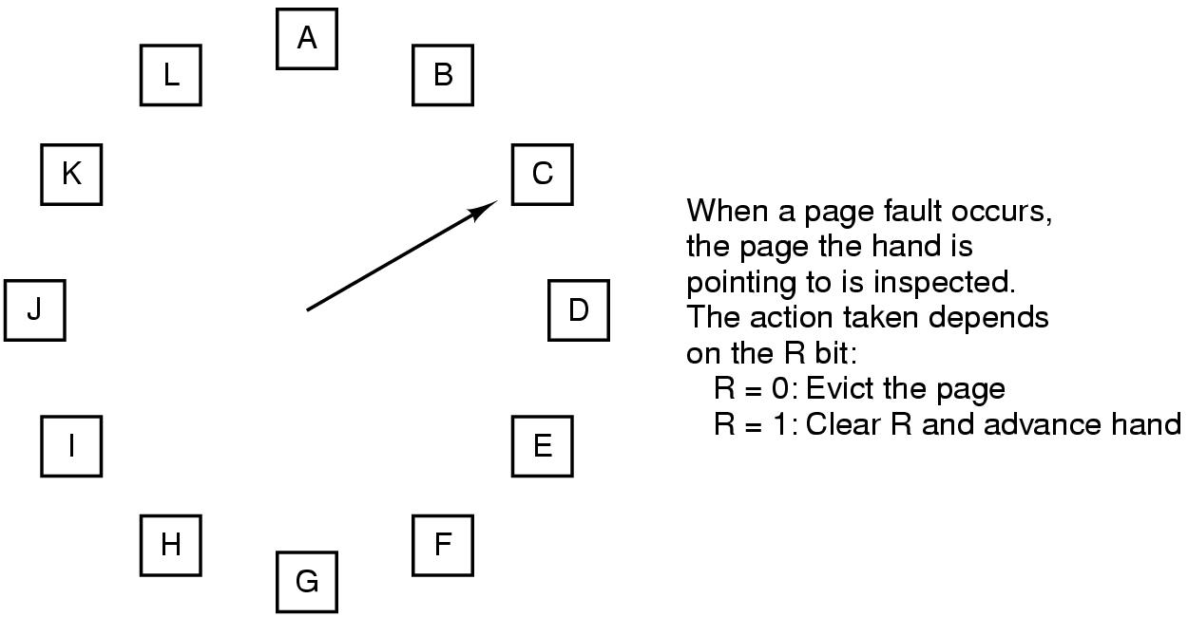
Online Version
Evict the block with the largest number of unused (i.e., no hit getting) pages
In case of tie, evict the block in LRU order

Slide 61
Status
LB-CLOCK: Published in the 17th Annual Meeting of the IEEE International Symposium on Modelling, Analysis and Simulation of Computer and Telecommunication Systems, Sept. 2009.
Offline algorithm Implemented.
New Online algorithm Implementation is in progress

Slide 62
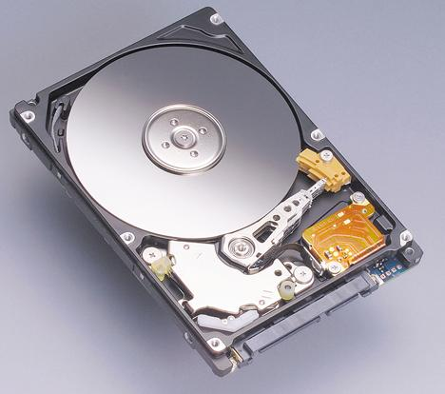
Big Picture: DB+SSD
Database Servers
SSD

Slide 63
Database Storage Manager
The interface between database systems and disk storage is in terms of disk pages of predetermined size (e.g., 8K, or 16K)
The data layout on disk is the N-ary storage model (NSM) where full records are stored consecutively within the disk page.
A new Buffer and Storage Manager inside database engine needs to designed which will be write-resistant

Slide 64
OLTP (Online Transaction Processing)
DSS (Decision Support System)
 | OLTP | DSS
Transaction | Regular business transactions Heavy on retrievals and updates Short and quick queries | Ad hoc queries on historical data Heavy on retrievals, light on updates Complex and long running queries
Performance | User response time critical | Complex queries User response not critical
Concurrent Users | Many | Few
Disk I/O | 60 - 80 % reads 20 - 40% writes Frequent disk writes New records are continually added and existing records are updated or deleted | 90 % reads, 10 % writes (except during builds) Relatively few disk writes Pages are moved in and out of cache
Source: Flash Solid State Disk Write Endurance in Database Environments, http://www.bitmicro.com/press_resources_flash_ssd_db.php

Slide 65
Problem Statement
Given Flash Characteristics
Design a new update processing methodology for the flash storage based DBMs
  Improves the update processing overhead
  Improves Longevity

Slide 66
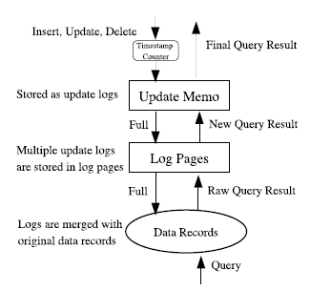
Lazy Update Methodology

Slide 67
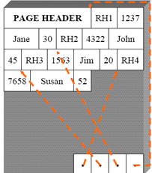
Erase Block : DBMS
Log Page

Slide 68
SSD View From DBMS
Log Page
…
Log Page
Update Memo
…
Log Page
SSD

Slide 69
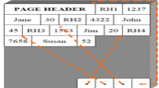
Insert, Update, and Delete
Log Page
…
Log Page
Insert log
Update log
Delete log
…
Log Page
SSD

Slide 70
Insert, Update, and Delete :
Memo is Full
Log Page
…
Log Page
Insert log
Update log
Delete log
…
Log Page
SSD

Slide 71
Insert, Update, and Delete :
Memo is Full (Contd.)
Log Page
…
Log Page
Insert log
Update log
Delete log
…
Log Page
SSD

Slide 72
Insert, Update, and Delete :
Memo and Log Page Full
Log Page
Log Page
Insert log
Update log
Delete log
Log Page

Slide 73
Merge: Log and Data Pages
Log Page
…
Log Page
Insert log
Update log
Delete log
…
Log Page
SSD

Slide 74
Query Processing
Log Page
…
Log Page
…
Log Page
SSD

Slide 75
Tuning Parameters
Number Log Pages in a Data Block
Number of blocks in the Update Memo

Slide 76
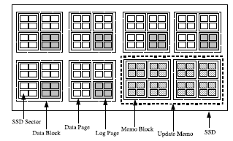
Why is It Beneficial?

Slide 77
SSD View From DBMS
Log Page
…
Log Page
Update Memo
…
Log Page
SSD

Slide 78
An Improvement
…
Update Memo 2
Update Memo 1
…
SSD

Slide 79
Enhancing Computing Performance and Power Saving with Flash Memory

Slide 80
Project Vision
Integrating flash memory into both primary memory and secondary storage architectures
Enhancing the performance with low power consumption
Making SSD into main stream products

Slide 81
DRAM, PC-RAM, NAND Flash and
NOR Flash Comparison (Mogul et al 2009)
Technology | Density | Endurance (cycles) | Rand. read time | Write time | Erase time | Erase Size | Idle “on” power
DRAM | 6-8 F² | 10¹⁵ | ∼ 40–60 ns | ∼ 40–60 ns | — | — | _4W–8W/DIMM
NAND flash | 4-5 F² | 10⁵ –10⁶ | 5–50 us | 200 us/page | 2 ms | e.g. 512KB | _0
NOR flash | 10 F² | 10⁵ –10⁶ | 70 ns | 1 us | 1 sec | e.g. 128KB | _0
PC-RAM | 8-16 F² | 10¹⁰ –10¹¹ | 60 ns? | 100–1000 ns | — | — | _0

Slide 82
Secondary Storage Hierarchical Model
Primary Memory Hierarchical Model
L3/L4 Cache
L3/L4 Cache
DRAM
DRAM
FLASH
Flash
Disk
Disk
To speed up I/O transfers and swaps
To save energy
To improve performance
To minimize I/O transfers and swaps
To reduce cost
To save energy

Slide 83
Flash as Memory, DRAM as Cache
Take FLASH’s density, cost, size, and power advantages.
Proposed Hierarchical Model
Parallel Model
L3/L4 Cache
L3/L4 Cache
DRAM
NOR Flash
DRAM
NAND FLASH
Disk
Pros: word addressable, fast read
Disk
Cons: expensive, extremely slow writes
less dense than NAND

Slide 84
Challenges of FLASH Main Memory
Slow Read
About 100x slower than DRAM (5us vs. 50ns)
For acceptable AMAT, hit rate should be > 90%
Slow Write
  Common problem of all FLASH
Wear Out Constraints
Although improving, still not suitable for normal primary memory. Could wear out in a short time.

Slide 85
Proposed Solutions
Slow Read
Rely on large block size (e.g. a page) and effective page based prefetching
Slow Write
Using DRAM cache as a write buffer to absorb writes. Using page attributes to guide effective allocation, replacement, and bypassing the Flash.
Wear Out Constraints
Using page attributes and wear-out aware algorithms to guide page allocation and garbage collection.
Using a write queue to collect and schedule a cluster of writes.

Slide 86
Hybrid Memory Organization
FLASH Main Memory
from Disk
DRAM Cache
TAG+
Data
To/from
L3 cache
TAG+
Data
TAG+
Data
TAG+
Data
TAG+ =
TAG += P (present in FLASH)
V (valid)
R (recently read)
W (recently write)
F (prefetched)
D (dirty)
and more
Write
Queue
to Disk

Slide 87
Page Attributes
Assume a DRAM cache line is a page. Each page has an attribute indicating the page’s common behavior, such as
read-only: typical code, fonts, video/audio
r/w-many: regular data
read-many, rarely write
write-many, rarely read
write-once: logs
temporary: temporary arrays, files
Page attributes can be used to guide allocation, replacement, and predicting future references

Slide 88
Page Attribute Setting
Page attributes can be set
  Static
    Compiler: based on program analysis (including system call analysis).
    OS: based on file types.
  Dynamic
    OS: based on actual file usages
    Hardware/Runtime profiler:
    use actual program’s runtime reference behavior.
    can correct statically set but inaccurate attributes.

Slide 89
Proposed Research
Memory reference behavior from very large L3 caches
eDRAM will yield very large on-chip L3 caches
DRAM cache organization and configuration
Page attribute setting/resetting
Page allocation, replacement with page attribute information in the DRAM cache
Page allocation and garbage collection with page attributes in the NAND FLASH
Page table design, implement, and management

Slide 90
Secondary Storage: Goals and Motivation
Improve the performance with flash memory
Storage demands are continuously growing by 60% annually, with chief triggers being
    growth in content richness of data
    compliance issues requiring stricter retention policies
Archival and Nearline storage footprints are growing faster
  Outpacing online storage footprint
  Could potentially overtake server power consumption with increased use of disks instead of tapes

Slide 91
Integrating SSD with Storage Hierarchy

Slide 92
Disk States and Power Usage
Spindle Motor (60 – 80%)
Transition Time ~10s
Startup Current ~ 10-15x
Idle: Spindle, Head &Buffer On
Sleep: SActive: Spindle, Head &
Active
Idle
14/3
8/1
Head Assembly (10-30%)
Buffers/Electronics(5-10%)
Typical Specs
(15K enterprise drives)
Idle Mode: 8-10W
Active: 12-14W
Standby: 2W
Standby
2/0.3
Sleep
15K FC 72GB
5K SATA 250GB
Active: Spindle, Head &Buffer On
Idle: Spindle & Buffer On Head Off
Standby: Spindle &Head Off, Buffer On
Sleep: Spindle, Head &Buffer Off

Slide 93
Inactive State Control
May be more or less desirable than active state control
  Inactive state power
  Entry and Exit latencies
Reactive control is the simplest
Queue emptied
Traffic arrives
No power control
BSY
Idle
BSY
Reactive exit:
Triggered by
traffic
BSY
Watch & wait
BSY
IDL→LPR
LPR→IDL
In LPR state
93
93

Slide 94
Proactive Control
Go to sleep for some predicted duration
  Accuracy of predicted duration is crucial
Can be useful at moderate utilizations
Proactive exit:
Done before
traffic arrival
BSY
Watch & wait
Idle
BSY
IDL→LPR
LPR→IDL
In LPR state
Proactive exit:
Not done by
traffic arrival
BSY
Watch & wait
BSY
IDL→LPR
LPR→IDL
In LPR state
94
94

Slide 95
Pros & Cons
Attribute | Reactive control | Proactive control
Complexity | Simple | Complex (requires gap prediction)
Latency | High (full cost on every exit) | Potentially lower (assuming good prediction)
Efficiency | High | Low (every low prediction hurts)
Initial wait time | Large (to offset high exit cost) | Can be small
Suitability wrt traffic parms | Correlation irrelevant Heavy tail generally good | Need significant positive correlation Heavy tail problematic
Suitability wrt exit_cost | Optimal for small exit_cost | Useful for large exit_cost
95

Slide 96
General Framework for Secondary Storage Architecture
SSD
Model
Program Profiling and Run-time Prediction
Program
and Data
Energy-Aware
Optimizer
Data Layout
Energy-Aware Prefetching/
Caching
Disk Energy Model

Slide 97
Propose Research
Basic Model Evaluation with Perfect Knowledge of Future Data Access Patterns
Optimal Prefetching and Caching for Best Performance and Lower Power Consumption
Optimal STOPs for Idle and Sleep States
Data Placement
Putting All Together

Slide 98
Making Checkpointing Faster
Using Flash Memory
Notes:
Review today, not so fast in future

Slide 99
Outline
Overview of Checkpointing
How does flash memory help?

Slide 100
Failure During Program Execution
Computers today are much faster, but applications are more complicated
Applications which still take a long time -
  (1) Database Updates
  (2) Fluid-flow Simulation - needed for weather and climate modeling
  (3) Optimization - optimal deployment of resources by industry (e.g. - airlines)
  (4) Astronomy - N-body simulations and modeling of universe
  (5) Biochemistry - study of protein folding
When execution time is very long - both probability of failure during execution and cost of failure become significant

Slide 101
Cost of Program Failure - Example
Program takes T hours to execute
System suffers transient failures - rate of λ failures per hour
Failure is instantaneous but all prior work is lost
E - expected total execution time including any computational work lost due to failures
If there are no failures during execution - a case which has probability e -
conditional expected total execution time = T
The probability that a failure will occur at τ hours into the execution is λe dτ
In this case, τ hours are wasted, the program has to be restarted and an additional expected time E is needed to complete the execution - conditional expected total execution time = τ+E
-λT
-λτ

Slide 102
Checkpointing - Definition
A checkpoint is a snapshot of entire state of the process at the moment it was taken - all information needed to restart the process from that point
Checkpoint saved on stable storage of sufficient reliability
Most commonly used - Disks: can hold data even if power is interrupted (but no physical damage to disk); can hold enormous quantities of data very cheaply
Checkpoints can be very large - tens or hundreds of megabytes
RAM with a battery backup is also used as stable storage
No medium is perfectly reliable - reliability must be sufficiently high for the application at hand

Slide 103
Overhead and Latency of Checkpoint
Checkpoint Overhead is the increase in the execution time of the application due to taking a checkpoint
Checkpoint Latency is the time needed to save the checkpoint
In a simple system - overhead and latency are identical
If part of the checkpointing can be overlapped with application execution - latency may be substantially greater than overhead
If a process checkpoints by writing its state into an internal buffer, the CPU continues execution while the checkpoint is written from buffer to disk

Slide 104
Checkpointing Latency - Example
for (i=0; i<1000000; i++)
if (f(i)<min) {min=f(i); imin=i;}
for (i=0; i<100; i++) {
for (j=0; j<100; j++) {
c[i][j] += i*j/min;
}
}
First part - compute the smallest value of some function f(i) for 0<i<1000000
Second part - multiplication followed by division

Slide 105
Size of Checkpoint in Example
Checkpointing latency depends on checkpoint size - can vary from program to program and even during the execution of one program
A checkpoint in the first part can be small - only program counter and the variables min and imin - most registers are not relevant
A checkpoint taken in the second part must include the array c[i][j] computed so far
In general: The size of checkpoint is program-dependent; as small as a few kilobytes or as large as several gigabytes

Slide 106
Issues in Checkpointing
How many checkpoints should we have?
At which points in the execution of a program should we checkpoint?
How can we reduce checkpointing overhead?
How do we checkpoint distributed systems in which there may or may not be a central controller?
At what level (kernel/user/application) should we checkpoint?
How transparent to the user should the checkpointing process be?

Slide 107
Reducing Overhead - Buffering
Processor writes checkpoint into main memory and then returns to executing the application
Direct memory access (DMA) is used to copy the checkpoint from main memory to disk
DMA requires CPU involvement only at the beginning and end of the operation
Refinement - copy on write buffering
Copying portions of the process state that are unchanged since the last checkpoint is a waste of time
If the process does not update the main memory pages too often - most of the work involved in copying the pages to a buffer area can be avoided

Slide 108
Copy on Write Buffering
Most memory systems provide memory protection bits (per page of physical main memory) indicating: (page) is read-write, read-only, or inaccessible
When checkpoint is taken, protection bits of pages belonging to the process are set to read-only
The application continues running while the checkpointed pages are transferred to disk
If the application attempts to update a page, an access violation triggers
The system then buffers the page, and the permission is set to read-write
The buffered page is later copied to disk

Slide 109
Reducing Checkpointing Overhead - Memory Exclusion
Two types of variables that do not need to be checkpointed - those that have not been updated and those that are “dead”
A dead variable is one whose present value will never again be used by the program
Two kinds of dead variables: those that will never again be referenced by the program, and those for which the next access will be a write
The challenge is to accurately identify such variables

Slide 110
Identifying Dead Variables
The address space of a process has four segments: code, global data, heap, stack
  Finding dead variables in code is easy - self-modifying code is no longer used, thus, the code segment in memory is read-only, and need not be checkpointed
  The stack segment is equally easy: contents of addresses held in locations below the stack pointer are obviously dead (the virtual address space usually has the stack segment at the top, growing downwards)
  Heap segment - many languages allow the programmer to explicitly allocate and deallocate memory (e.g., the malloc() and free() calls in C) - the contents of the free list are dead by definition
  Some user-level checkpointing packages (e.g., libckpt) provide the programmer with procedure calls (e.g., checkpoint_here()) that specify regions of the memory that should be excluded from, or included in, future checkpoints

Slide 111
Reducing Latency
Checkpoint compression - less has to be written to disk
How much is gained through compression depends on:
  Extent of the compression - application-dependent - can vary between 0 and 50%
  Work required to execute the compression algorithm - done by CPU - adds to the checkpointing overhead as well as to the latency
In simple sequential checkpointing where tc = tl - compression may be beneficial
In more efficient systems where tc << tl - usefulness of this approach is questionable and must be carefully assessed before use

Slide 112
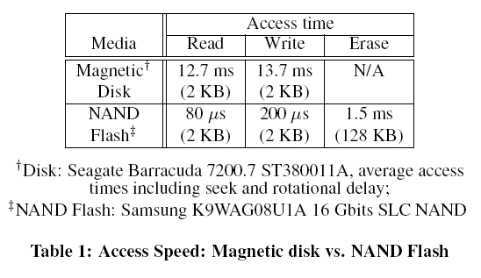
Flash Memory

Slide 113
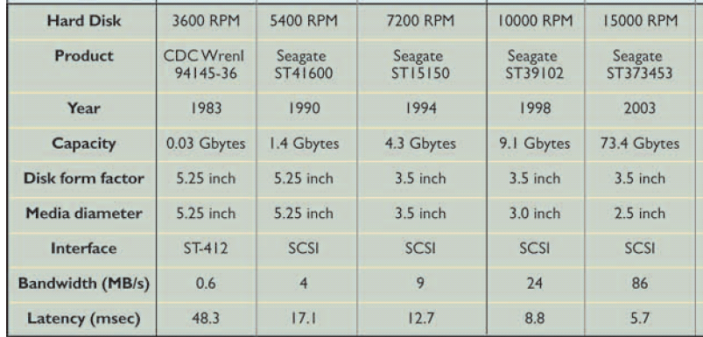
Disk Bandwidth
Source: Latency lags bandwidth, David Patterson, Communications of the ACM Volume 47 , Issue 10 (October 2004)

Slide 114
Flash Bandwidth
 | Sequential |  |  | Random 4K
 | Read | Write |  | Read | Write
USB | 11.7 MB/sec | 4.3 MB/sec |  | 150/sec | 20/sec
MTron | 100 MB/sec | 80 MB/sec |  | 11K/sec | 130/sec
Zeus | 200 MB/sec | 100 MB/sec |  | 52K/sec | 11K/sec
FusionIO | 700 MB/sec | 600 MB/sec |  | 87K/sec | Not avail
Source: Design Tradeoffs for SSD Performance. Nitin Agrawal, Vijayan Prabhakaran, Ted Wobber, John D. Davis, Mark Manasse, Rina Panigrahy.
Usenix Annual Technical Conference (USENIX '08), June 2008.

Slide 115
Flash as a Log Device
DRAM (NV)
FLASH
Evictions
WRITE
WRITE
Write Cache
Destage Buffer
New Writes

Slide 116
Level 2: Flash Memory
Check pointing data is mostly sequential
Flash is good for sequential writes.
Flash can acts a fast destage buffer
DRAM
Evictions
Evictions

Slide 117
Thank You!
Comments / Questions?

